Slide 1

DOST CODE: 11219
ESTD:2022
BBR DEGREE COLLEGE
Balapur ,Hyd.
BADDAM BHOOPAL REDDY DEGREE COLLEGE
(Affiliated to Osmania University ) (Co –Education)
BBA
B.COM
Computer
Applications

Slide 2


College
Selection!

Slide 3
COLLEGE ADVANTAGES TO THE STUDENTS
Affiliation and Recognition
Infrastructure
Digital A/C Class room
Computer lab
library
Curriculam
Pedagogy
Campus Placements
9) Admissions
10) Co-Curricular Activities
11) Extra-Curricular Activities etc

Slide 4
College Affiliation and Recognition
BADDAM BHOOPAL REDDY DEGREE COLLEGE
  Affiliated to Osmania University, Hyderabad

Slide 5
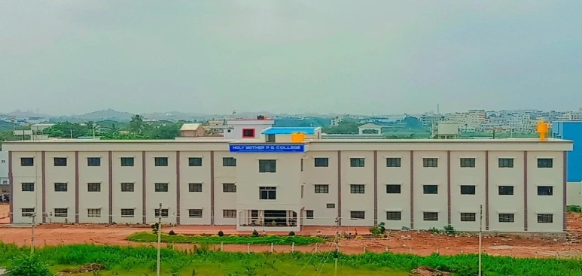
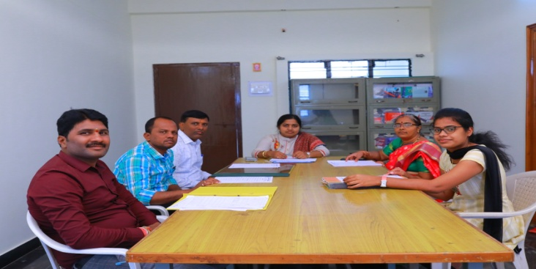
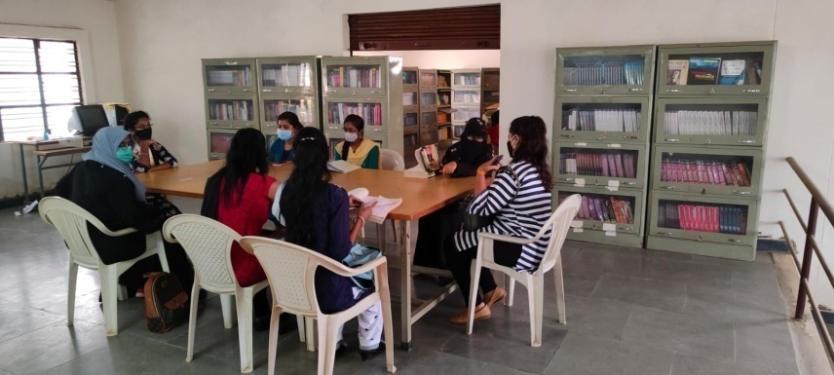
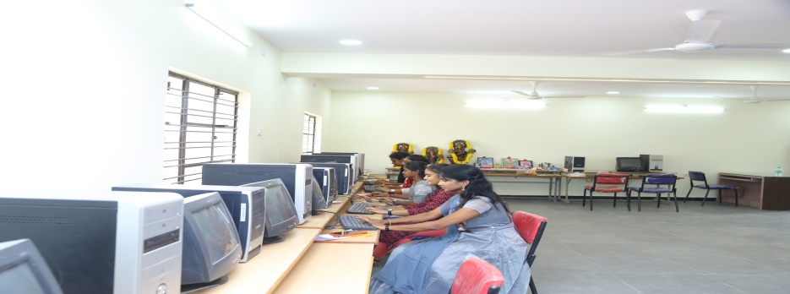
INFRASTRUCTURE
CONFERENCE HALL
COLLEGE CAMPUS
COMPUTER LAB
LIBRARY

Slide 6
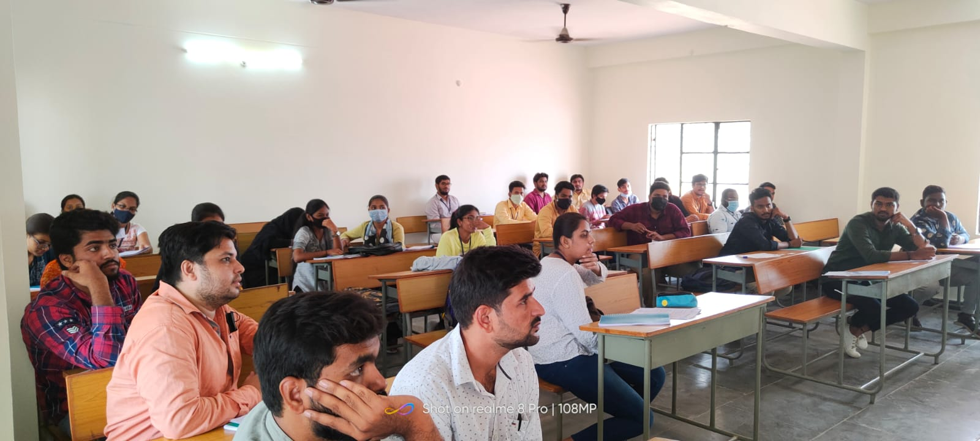
CLASS ROOM

Slide 7
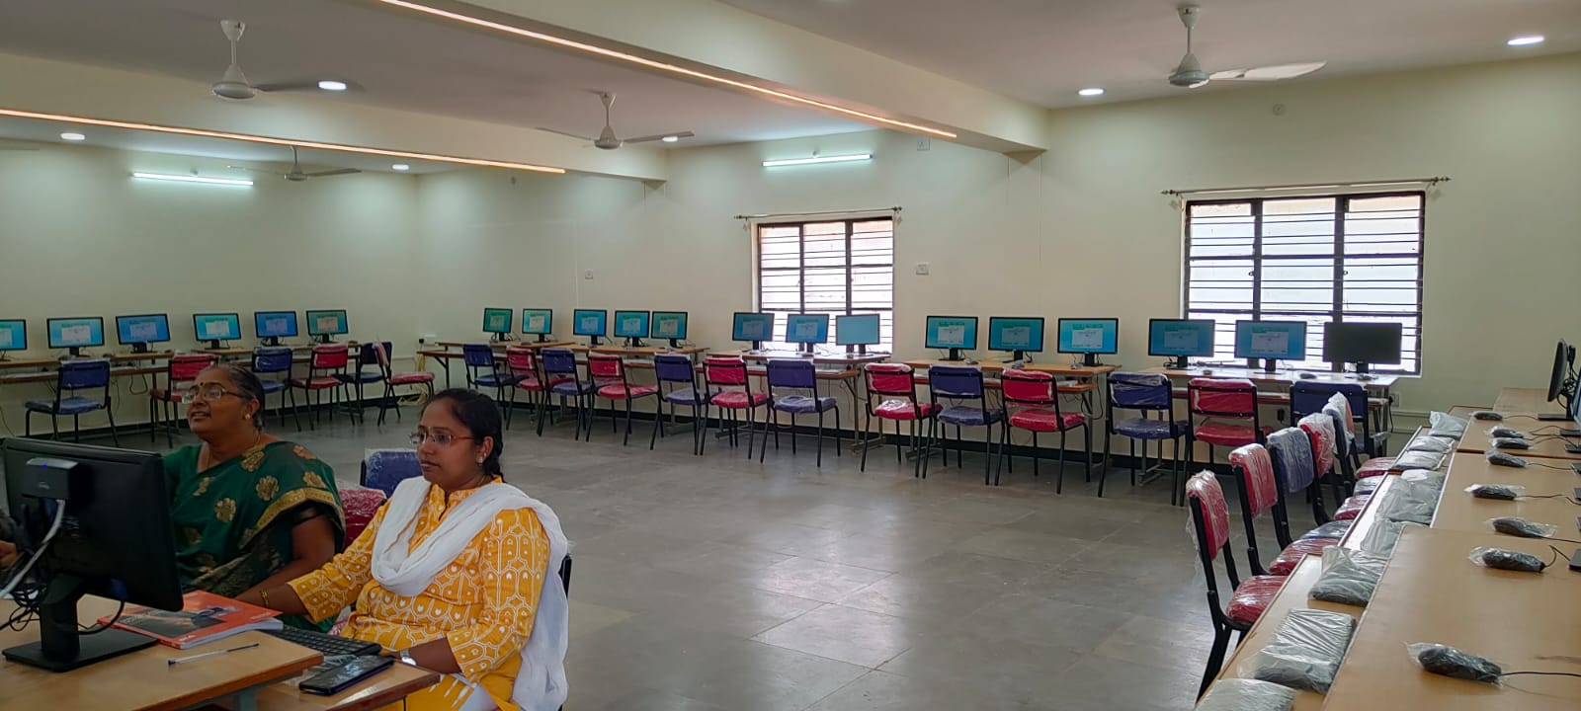
COMPUTER LAB

Slide 8
CURRICULUM
OU prescribed curriculum Academic Calendar & Curriculum (Affiliated College)
Implemented CHOICE BASED CREDIT SYSTEM (CBCS)
Well qualified & competent teaching faculty
Delivery of Syllabus Content
  COURSE STRUCTURE
  SYLLABUS COVERAGE
  LESSON PLAN
  LECTURE DIARY
  COURSE MATERIAL
Remedial & Tutorial Classes For Academically Slow Learners
Expert / Guest Lectures and Seminars
Management Fests.

Slide 9
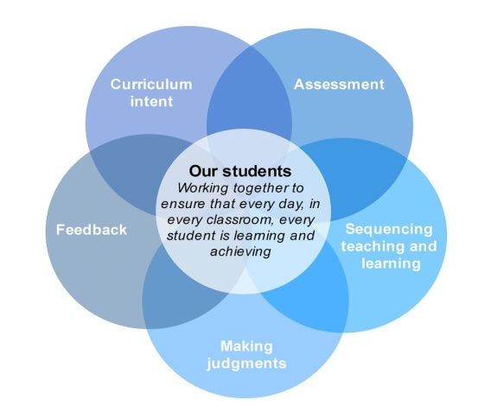
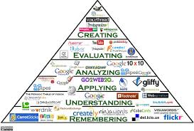
PEDAGOGY
Student centric Teaching Method .
Modern Teaching Methods:
  Digital classrooms
  Online videos by experts
  Design Thinking (Case Method) & Self-learning
Continuous Evaluation Procedure
    ASSIGNMENTS
    INTERNAL EXAMS
    SEMESTER EXAMS

Slide 10



Industry Accreditation

Slide 11

CAMPUS PLACEMENTS
Most important factor Placements
Providing CRT Training to the students.
Conducting Mock Tests & Interviews for the final year student
Campus Placement records of past five years of institution of 60%.
Have an eye over the pay packages 3.0 LPA (Avg).
Consistency in 60 % of placements is very credible aspect.

Slide 12
BBA ,B.COM SEATS ALLOTED BY OU FOR Academic Year 2023-24
B.COM(COMPUTER APPLICATION)
BRANCH | INTAKE
B.COM | 120
BBA
BRANCH | INTAKE
BBA | 60

Slide 13
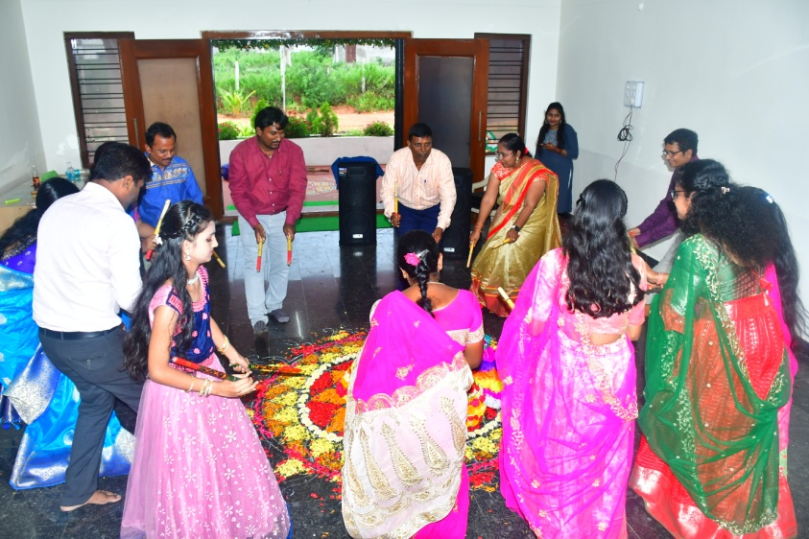
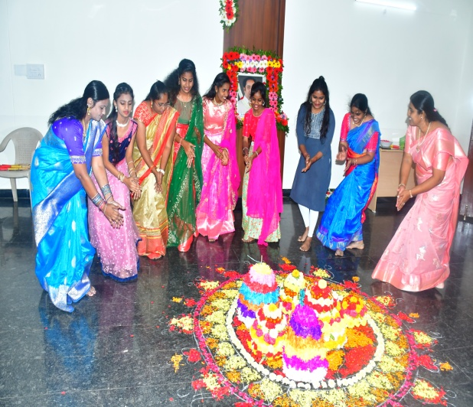
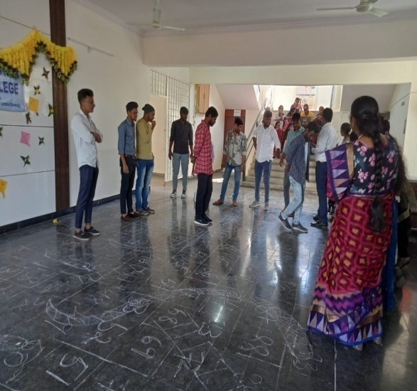
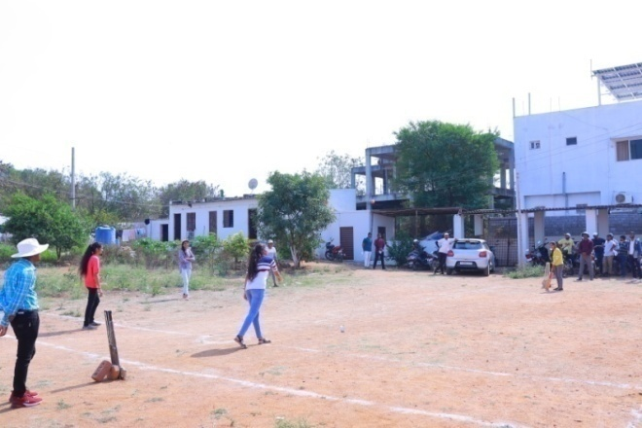
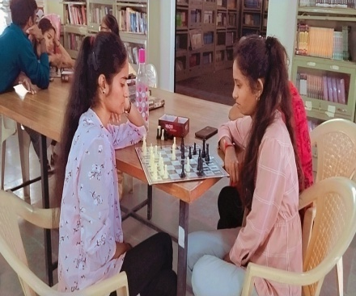
Co-Curricular and Extra Curricular Activities

Slide 14
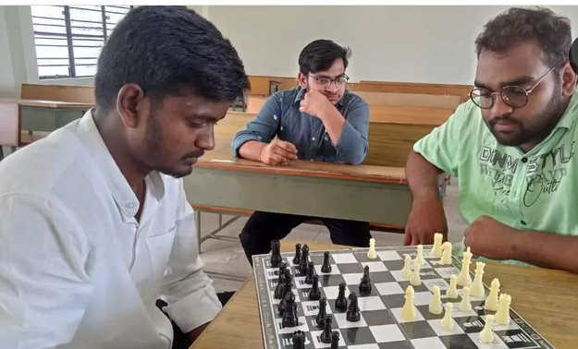
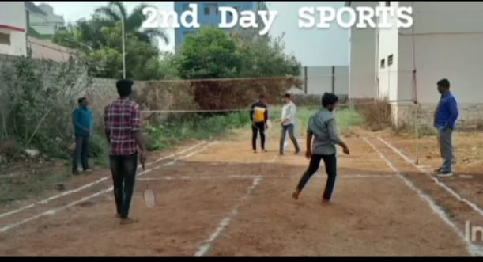
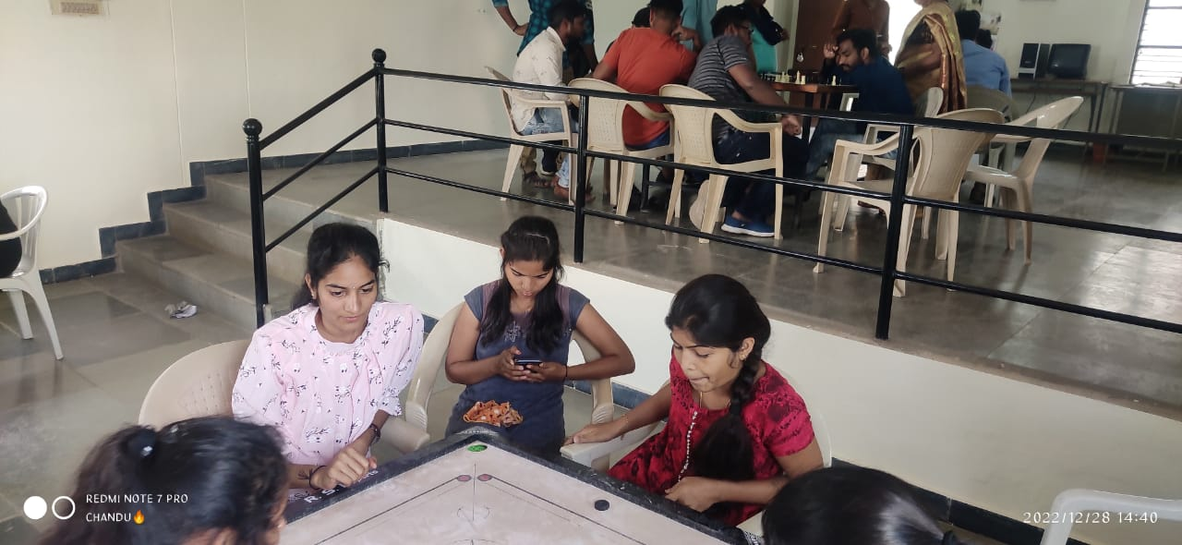
SPORTS

Slide 15
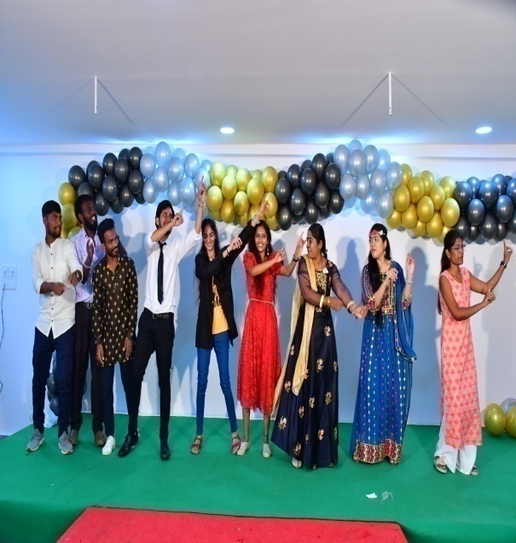

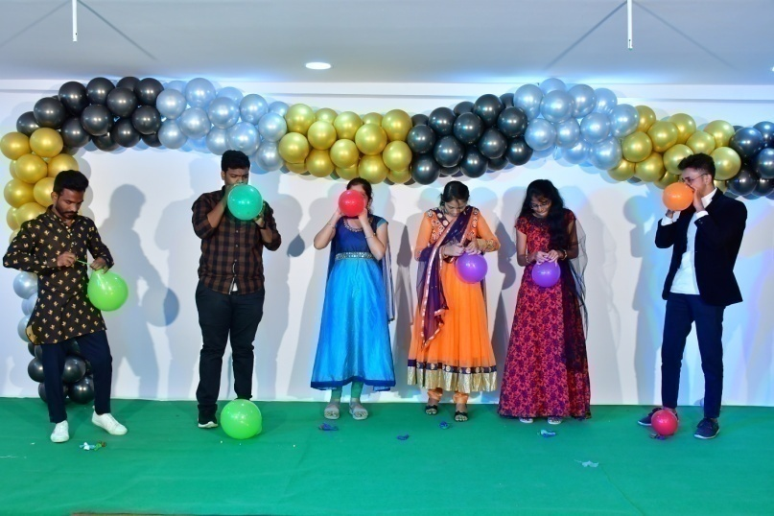
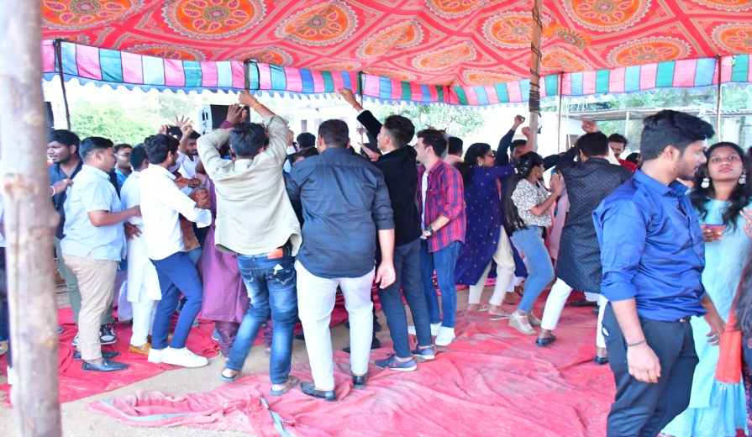
)
FRESHERS DAY 2022

Slide 16
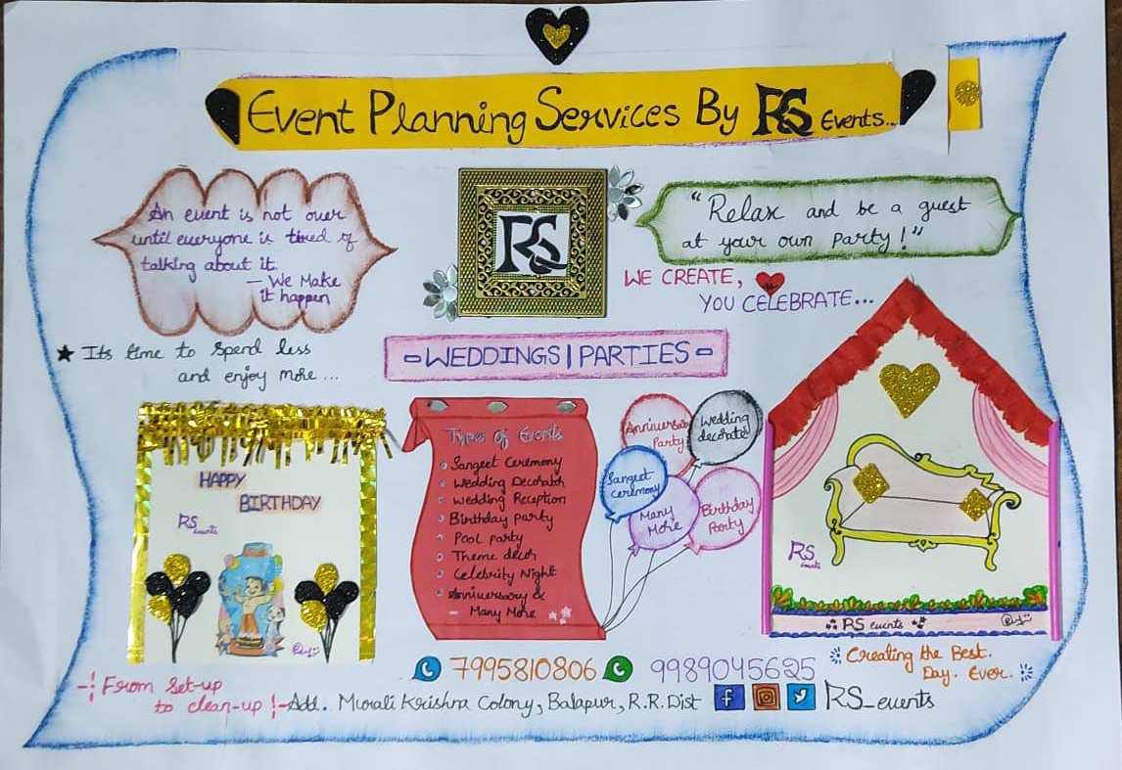
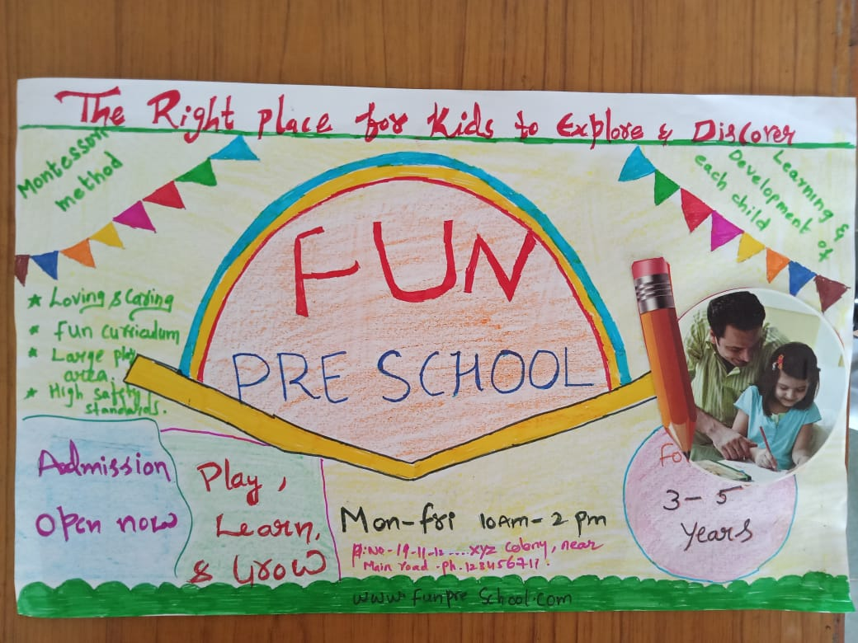
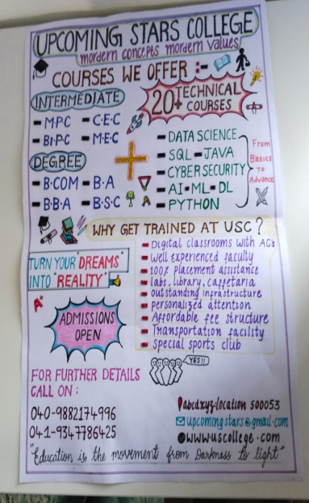
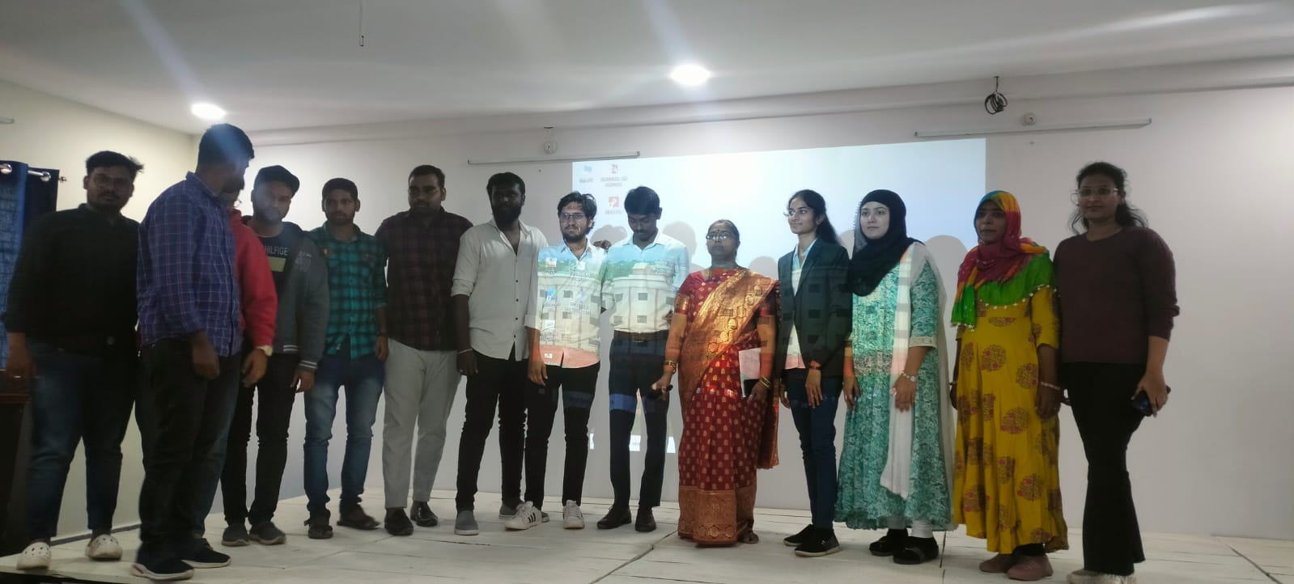
Student Activate Cell(SAC)

Slide 17
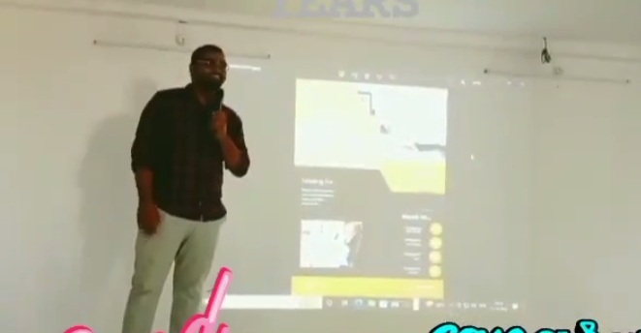
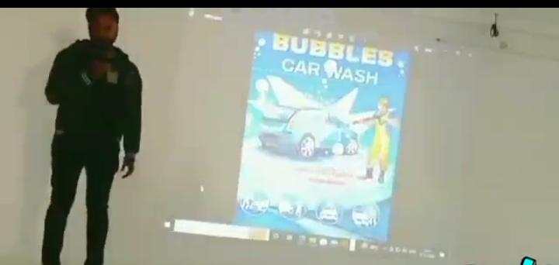
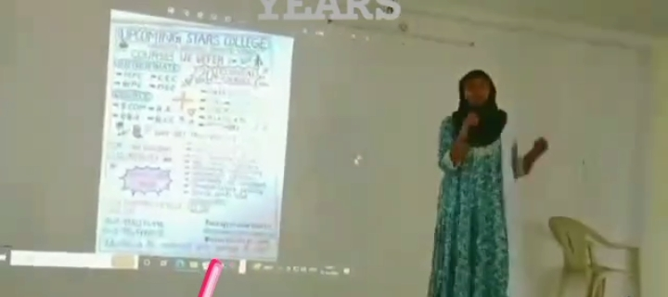
PRESENTATION

Slide 18
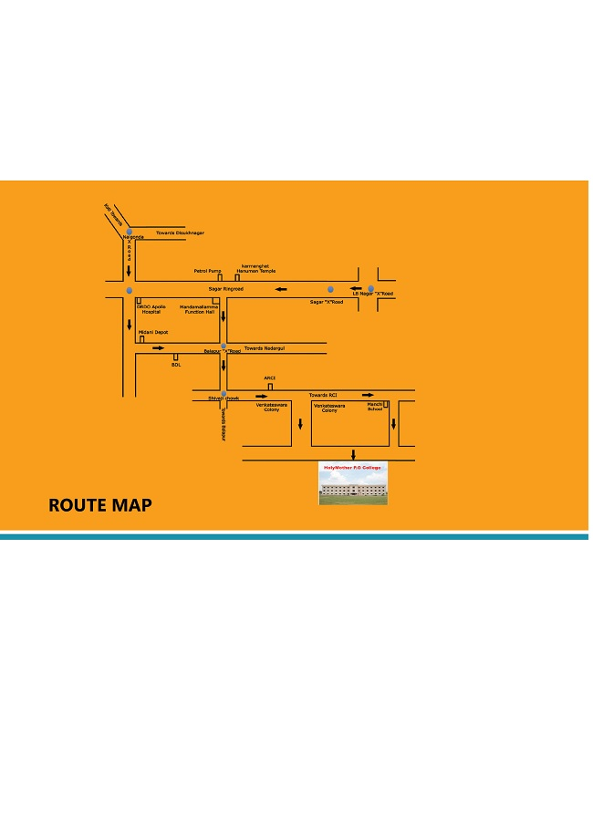
ROUTE MAP

Slide 19



